Slide 1
CIS 565 FINAL PROJECT CUDA Feature Matching and Object Tracking Milestone 2 by Yash Vardhan

Slide 2

MILESTONES
Week 1 – Object Tracking on CPU
Week 2 – Object Tracking on GPU and optimizations.
Week 3 – Feature Matching on CPU
Week 4 – Feature Matching on GPU and optimizations.

Slide 3
CHALLENGES TO Changes
The most time intensive part – getting the GPU implementation to get the same correct results as CPU (completed by Friday morning !)
Computing Gaussian Filters through changing openCV’s FFT calls to cuFFT calls such that spatial to frequency domain transform included DOUBLE instead of FLOAT to be later used in frequency to spatial transform – 18 ms saved locally (2.3x speedup)
Used openCV’s GpuMat instead of Mat when calling kernels – 3ms saved
Calculating Covariance Matrix to update input features(PCA) a.k.a. matrix multiplication of X (input pixels) and X-transpose – 11 ms saved

Slide 4
PERFORMANCE ANALYSIS

Slide 5
565 OPTIMIZATIONS

Slide 6
565 OPTIMIZATIONS Part 2

Slide 7
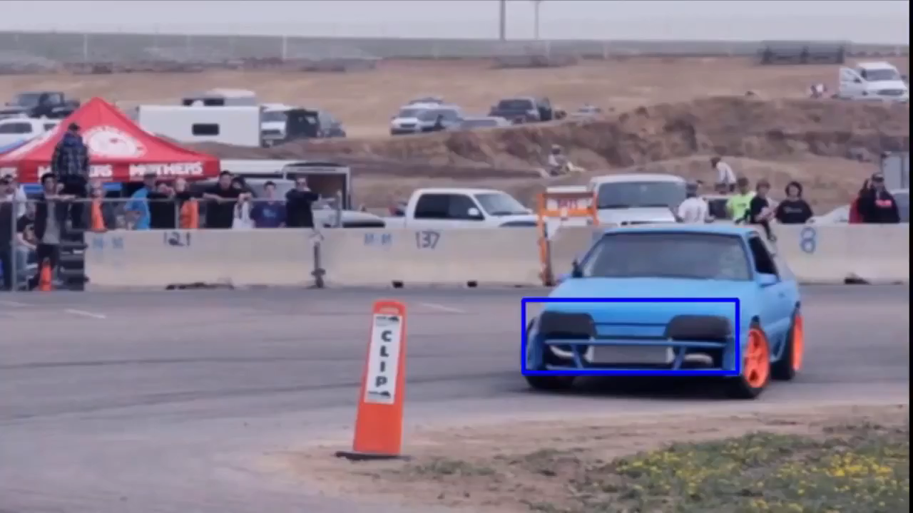
RESULT

Slide 8
NEXT WEEK
Feature Matching !! (Maybe CPU First)

